Slide 1

Characters
Feature Menu
What Characters Tell Us
Direct Characterization
Indirect Characterization
Dramatic Monologue and Soliloquy
Flat, Round, and Stock Characters
Practice

Slide 2

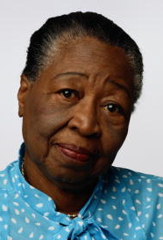

What Characters Tell Us
What can we learn from fictional characters?
We can learn about
  encounters with discrimination
  conflicts between old and new traditions
  struggles for independence and acceptance
  triumphs, fears, and love

Slide 3

What Characters Tell Us
Characters are the actors in a story. When they behave in convincing ways, they make us believe in them and draw us into their fictional worlds.
  By reading about their struggles, we often learn something about ourselves.
[End of Section]

Slide 4
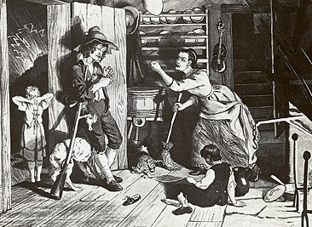
Direct Characterization
Direct Characterization—The writer or narrator tells readers directly what a character is like.
. . . he was a simple, good-natured man; he was moreover a kind neighbor and an obedient, henpecked husband.
from “Rip Van Winkle” by Washington Irving
[End of Section]

Slide 5

Indirect Characterization
Indirect Characterization—The writer reveals characters’ traits through
  appearance
  dialogue
  private thoughts
  actions
  effects on others

Slide 6
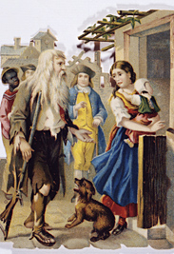
Indirect Characterization
Appearance / Name
The way writers describe characters’ appearance—
physical features, clothing, and general
demeanor—provides insight into their
personalities.
(After his twenty-year nap)
The appearance of Rip, with his long grizzled beard, his rusty fowling piece, his uncouth dress, . . . soon attracted the attention of the tavern politicians.
from “Rip Van Winkle” by Washington Irving

Slide 7
Indirect Characterization
Dialogue
Dialogue can reveal a lot about characters. Pay attention not only to what characters say but also how they say it.
(Entering the village after his twenty-year nap)
“God knows,” exclaimed [Rip] . . ., “I’m not myself.—I’m somebody else—that’s me yonder—no—that’s somebody else got into my shoes—I was myself last night; but I fell asleep on the mountain—and they’ve changed my gun—and everything’s changed—and I’m changed—and I can’t tell what’s my name, or who I am!”
from “Rip Van Winkle” by Washington Irving

Slide 8
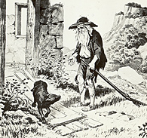
Indirect Characterization
Private Thoughts
Characters’ private thoughts can reveal what they think, feel, want, or fear.
(Rip learns that friends have passed away in his absence)
Rip’s heart died away, at hearing of these sad changes in his home and his friends, and finding himself thus alone in the world . . . he had no courage to ask after any more friends, but cried out in despair, “Does nobody here know Rip Van Winkle?”
from “Rip Van Winkle” by Washington Irving

Slide 9
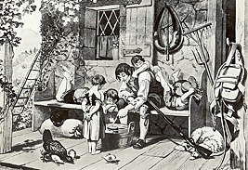
Indirect Characterization
Actions
Characters’ actions—what they do and how they do it—tell a great deal about them.
He assisted at their sports, made their playthings, taught them to fly kites and shoot marbles, and told them long stories. . . .
from “Rip Van Winkle” by Washington Irving

Slide 10
Indirect Characterization
Effects on Others
The effect a character has on others also helps readers understand what the character is like.
The children of the village . . . would shout with joy whenever he approached. . . . Whenever he went dodging about the village he was surrounded by a troop of them . . . and not a dog would bark at him throughout the neighborhood.
from “Rip Van Winkle” by Washington Irving

Slide 11

Indirect Characterization
Quick Check
In what indirect ways does the writer reveal character in this passage?
[Rip] would never refuse to assist a neighbor even in the roughest toil, and was a foremost man at all country frolics for husking corn, or building stone fences; the women of the village too used to employ him to run their errands . . .
from “Rip Van Winkle” by Washington Irving
[End of Section]

Slide 12


Indirect Characterization
Quick Check
In what indirect ways does the writer reveal character in this passage?
[Rip] would never refuse to assist a neighbor even in the roughest toil, and was a foremost man at all country frolics for husking corn, or building stone fences; the women of the village too used to employ him to run their errands . . .
from “Rip Van Winkle” by Washington Irving
The writer describes Rip’s actions—he always helps others.

Slide 13
Dramatic Monologue and Soliloquy
Characters are also important in poetry and plays. One way that poets and playwrights can develop characters is by letting them speak for
themselves.
  A dramatic monologue is a poem in which a single character talks to one or more silent listeners.
  A soliloquy is a scene in a play in which a lone character tells his or her thoughts directly to the audience.
[End of Section]

Slide 14


Flat, Round, and Stock Characters
Flat characters
  have only one or two character traits
  can be described in a few words
  are usually minor characters

Slide 15

Flat, Round, and Stock Characters
Round characters
  have many character traits
  are complex, like real people
  are often major characters

Slide 16
Flat, Round, and Stock Characters
Stock characters
  fit readers’ preconceived ideas about “types,” such as mad scientists or nagging wives
  are not complex like real people
[Rip’s] wife kept continually dinning in his ears about his idleness, his carelessness, and the ruin he was bringing on the family. Morning, noon, and night, her tongue was incessantly going. . . .
from “Rip Van Winkle” by Washington Irving
[End of Section]

Slide 17

Practice
Think about Rainsford or Zaroff. List details in the story that illustrate those traits. Then, identify which literary device (such as narration, dialogue, or description) helped you identify each trait.
Character Traits | Supporting Details | Literary Device Used
[End of Section]

Slide 18

The End

